Slide 1

AngularJS
Dependency manager : npm & bower

Slide 2
DO I need dependency managment?
Yes!
Dependencies must not be mixed with app code base
Dependencies must be kept up to date
Javascipt projects use A LOT a dependencies
4 month old project: 100+ deps

Slide 3
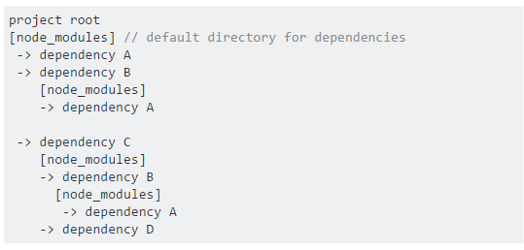
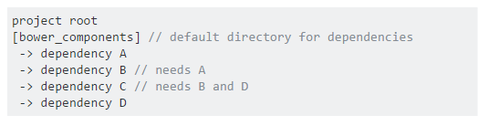
2 ways of managing dependencies
nested dependency tree
flat dependency tree

Slide 4
So which one is the best?
Nested dependency tree
Great on the server (don't have to care about space and latency)
No dependency conflicts (all your dependencies use their own version)
doesn't work that well on the front-end: imagine a site having to download three copies of jQuery.
Flat dependency tree
Only one version for each package
Minimal load (front-end friendly)
Dependency conflict must be dealt with by the developer
All package managers have many downsides. You just have to pick which you can live with.

Slide 5
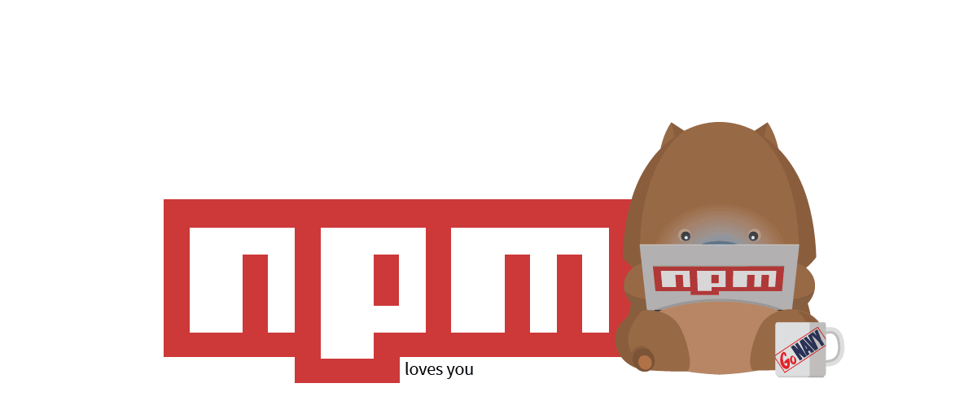
npm
Node Packet Manager
npm is most commonly used for managing Node.js modules
Use a nested dependency tree: It is much harder to avoid dependency conflicts without nesting dependencies.

Slide 6
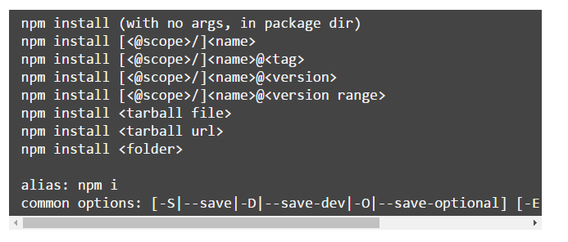
npm
Usage:

Slide 7
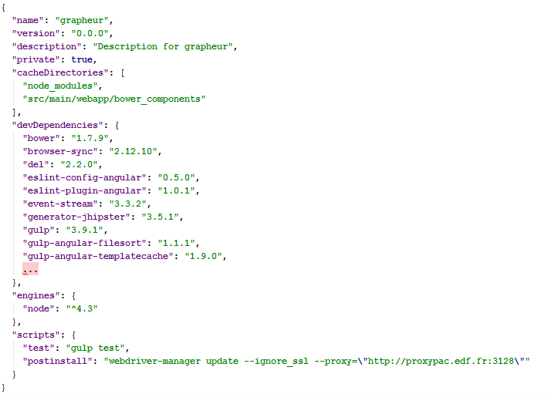
npm
Package.json

Slide 8


BOWER
Bower is a node packet
must be installed with npm:
Bower is created solely for the front-end and is optimized with that in mind.
Bower uses a flat dependency tree, requiring only one version for each package, reducing page load to a minimum.

Slide 9
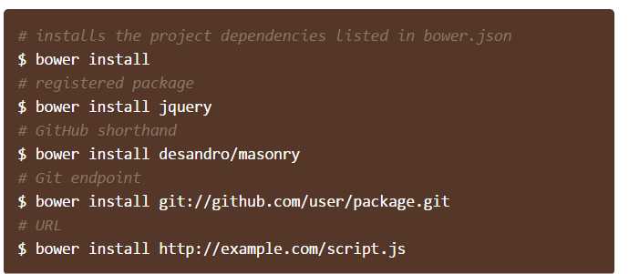
BOWER
Usage:
Use –save option to add the poackage in bower.js

Slide 10
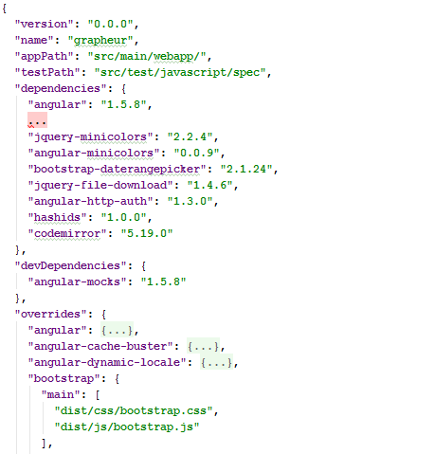
BOWER
bower.json (app)

Slide 11
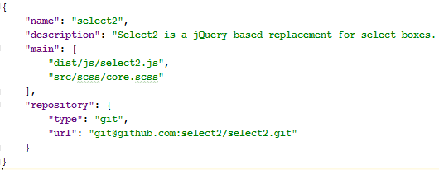
BOWER
bower.json (LIB)
Files in « main » property must be included in the app
Manually
Or using a build tool (ex: gulp-inject)

Slide 12
publishing
TODO

Slide 13
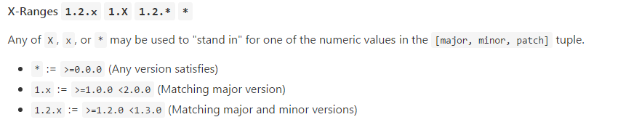
Semver
Format: X.Y.Z (Major.Minor.Patch)
MAJOR version when you make incompatible API changes,
MINOR version when you add functionality in a backwards-compatible manner, and
PATCH version when you make backwards-compatible bug fixes.
Ranges:

Slide 14
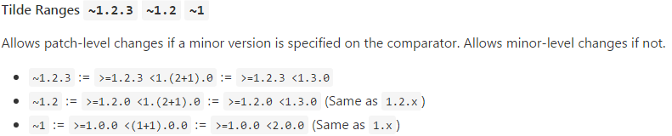
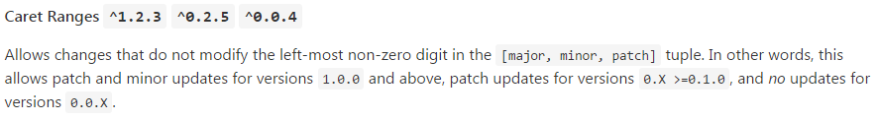

Semver
When in doubt: https://semver.npmjs.com/

Slide 15
some words of advice
Best practice:
don't trust anyone
do not use range
Use static versions of dependencies
Do not update blindly :
Read git changelogs of your libs (especially « small ones »)
There is a package for that: https://www.npmjs.com/package/npm-check-updates
Be aware: The dependencies you are using may use ranges for their child dependencies…

Slide 16
some words of advice
Dependency managment is essential, especially in a fast moving ecosystem like JavaScript
Dependency managment is a task in the project lifecycle:
It must be discussed by the team
It must be planned
It must be tested
Warning: Dependencies managers don't play well with security policy

